Slide 1
The Interagency Fire Prevention Campaign Equipment Caused Fires

Slide 2
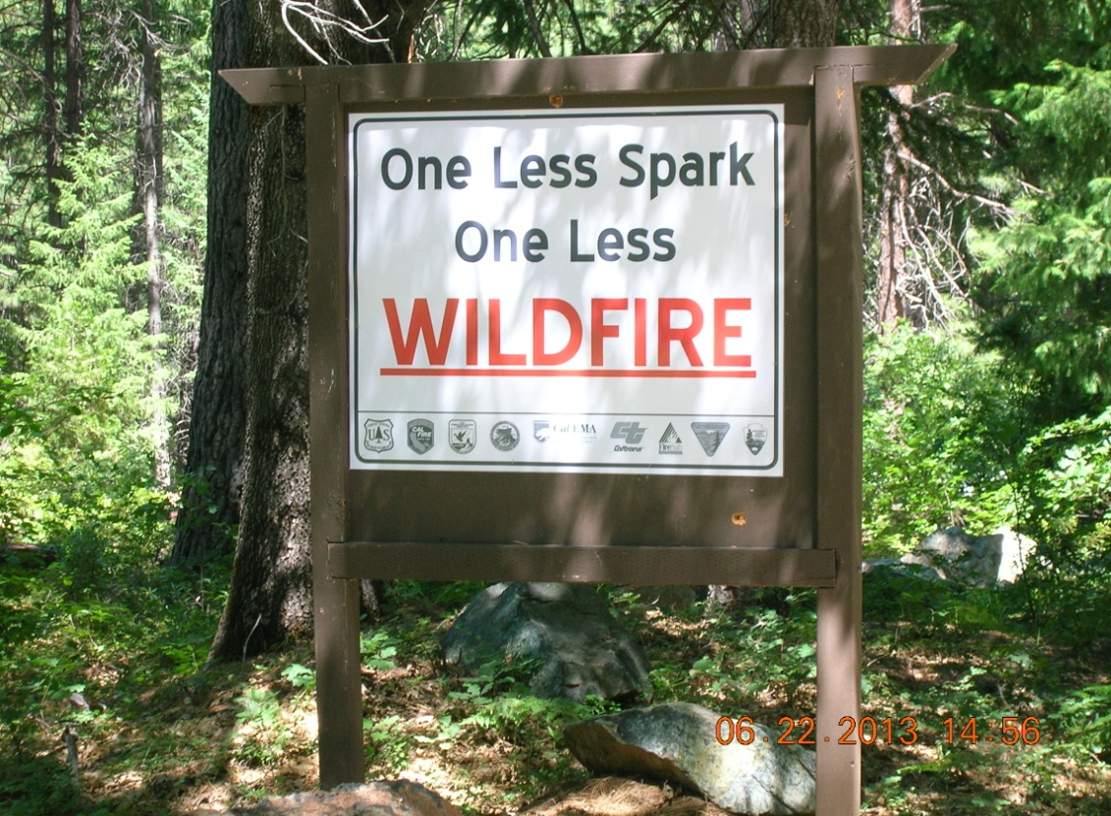
The Vision
One Less Spark-One Less Wildfire fire prevention campaign is to create a proactive cooperative approach to prevent or reduce the catastrophic losses associated with vehicle and equipment caused wildfires along the California highways.

Slide 3
Past Equipment Fires
Fawndale Fire 2001
70 acres
$548,500 (estimated cost)
Parks Fire 2006
139 acres
$1,089,200 (estimated cost)
Pigeon Fire
September 2, 2006
35,101 acres
$32,100,000 (estimated cost)
Delta Fire
August 17, 2007
8.5 acres
$66,600 (estimated cost)
Gulch Fire
September 17,2008
2,847 acres
$3,900,000 (estimated cost)
Notes:
Average cost per acre 987.92.

Slide 4
Campaign Objectives
Reduce exposure to firefighters and provide for public safety
Increase motorists awareness of safe driving operations
Protect public and private lands from damaging fires
Protect habitat for wildlife species
Protect headwaters for recreation, safe drinking water, and agricultural production

Slide 5
Action Plan
Target areas identified in high risk.
Install fire danger signs to increase situational awareness along highways.
Information brochures/posters to be posted at kiosks regarding vehicle safety during potential emergency situations.
Electronic billboard messaging to increase educational messages and situational awareness of the dangers associated with equipment fires in the area.

Slide 6
Measurable Indicators
Increased awareness of safe vehicle operations
Decreased number of fire occurrences
Reduction in suppression cost of wildland fires
Reduction of property loss from human-caused fires

Slide 7
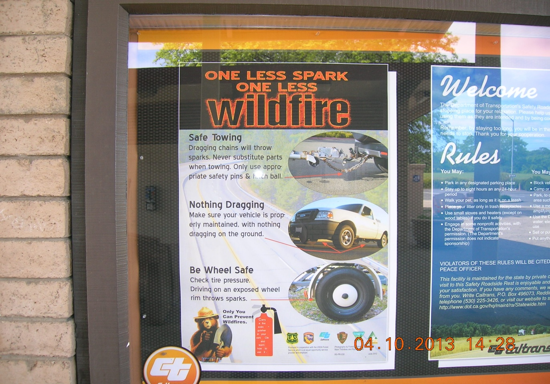
Caltrans Rest Area Kiosk

Slide 8
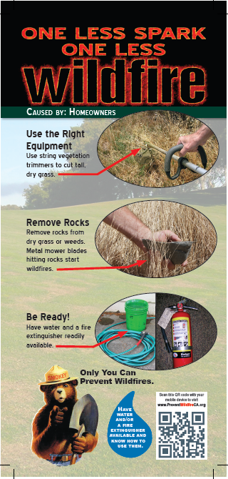
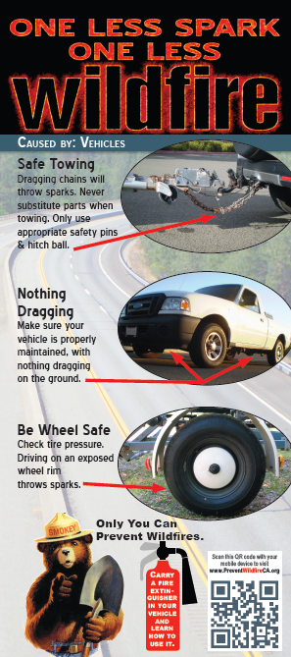
Rack Cards
Notes:
Brochure holders are cheap and make a very respectable presentation to local business owners.
The rack cards are at visitors centers, marinas, Uhaul stores, truck stops, RV shops, trailer shops, and atv shops. Please ask to place the cards along with a rack card holder at these locations. The business may want to hand them out in a sales package as well. Not a bad idea to attach a business card to the holder so they can call for more when they run out.

Slide 9
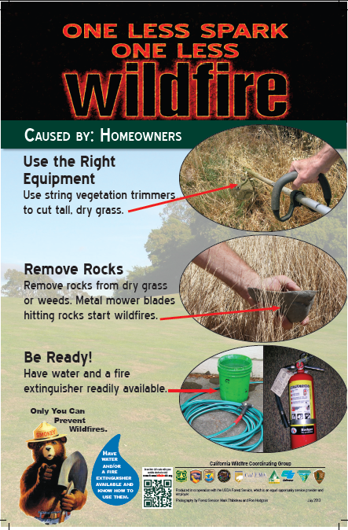

Slide 10
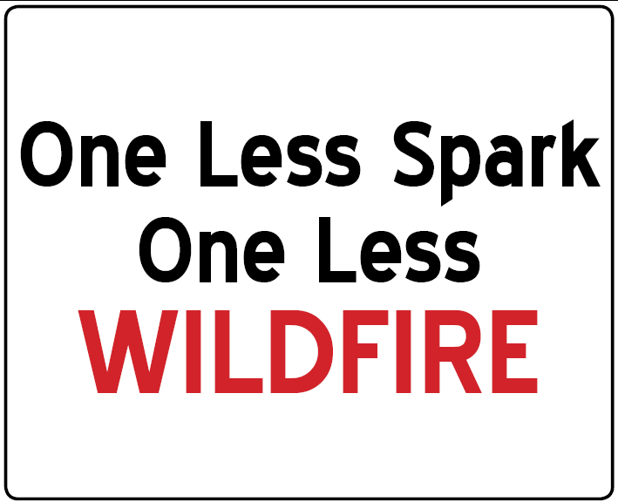
Highway Sign
Notes:
Highway grade reflective aluminum signs. These signs are ready for production in two different sizes. Ordered through P&M sign company in New Mexico. The sign placement works well in high traffic areas such as boat launches, ATV trailheads, truck stops, or adjacent to Cal Trans right of way. A traveler notices the sign then stops at a rest area and sees a poster then stops in the Forest Service office and receives a rack card.

Slide 11
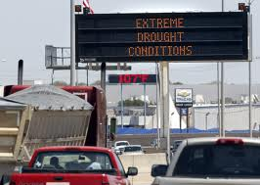
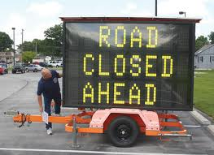
Notes:
Messages could include
High Fire Danger
Extreme Drought Conditions
Prescibed Fire Do Not Report
BI’s are the major consideration.
70%BI and 80%POI
Trigger Points for Highway Signs…Temp 90 RH 22 BI 70
Who is responsible for the implimentation. Forest/Dispatch/Fire Prevention

Slide 12
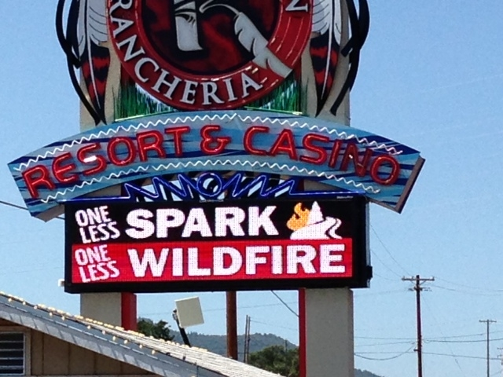

Slide 13
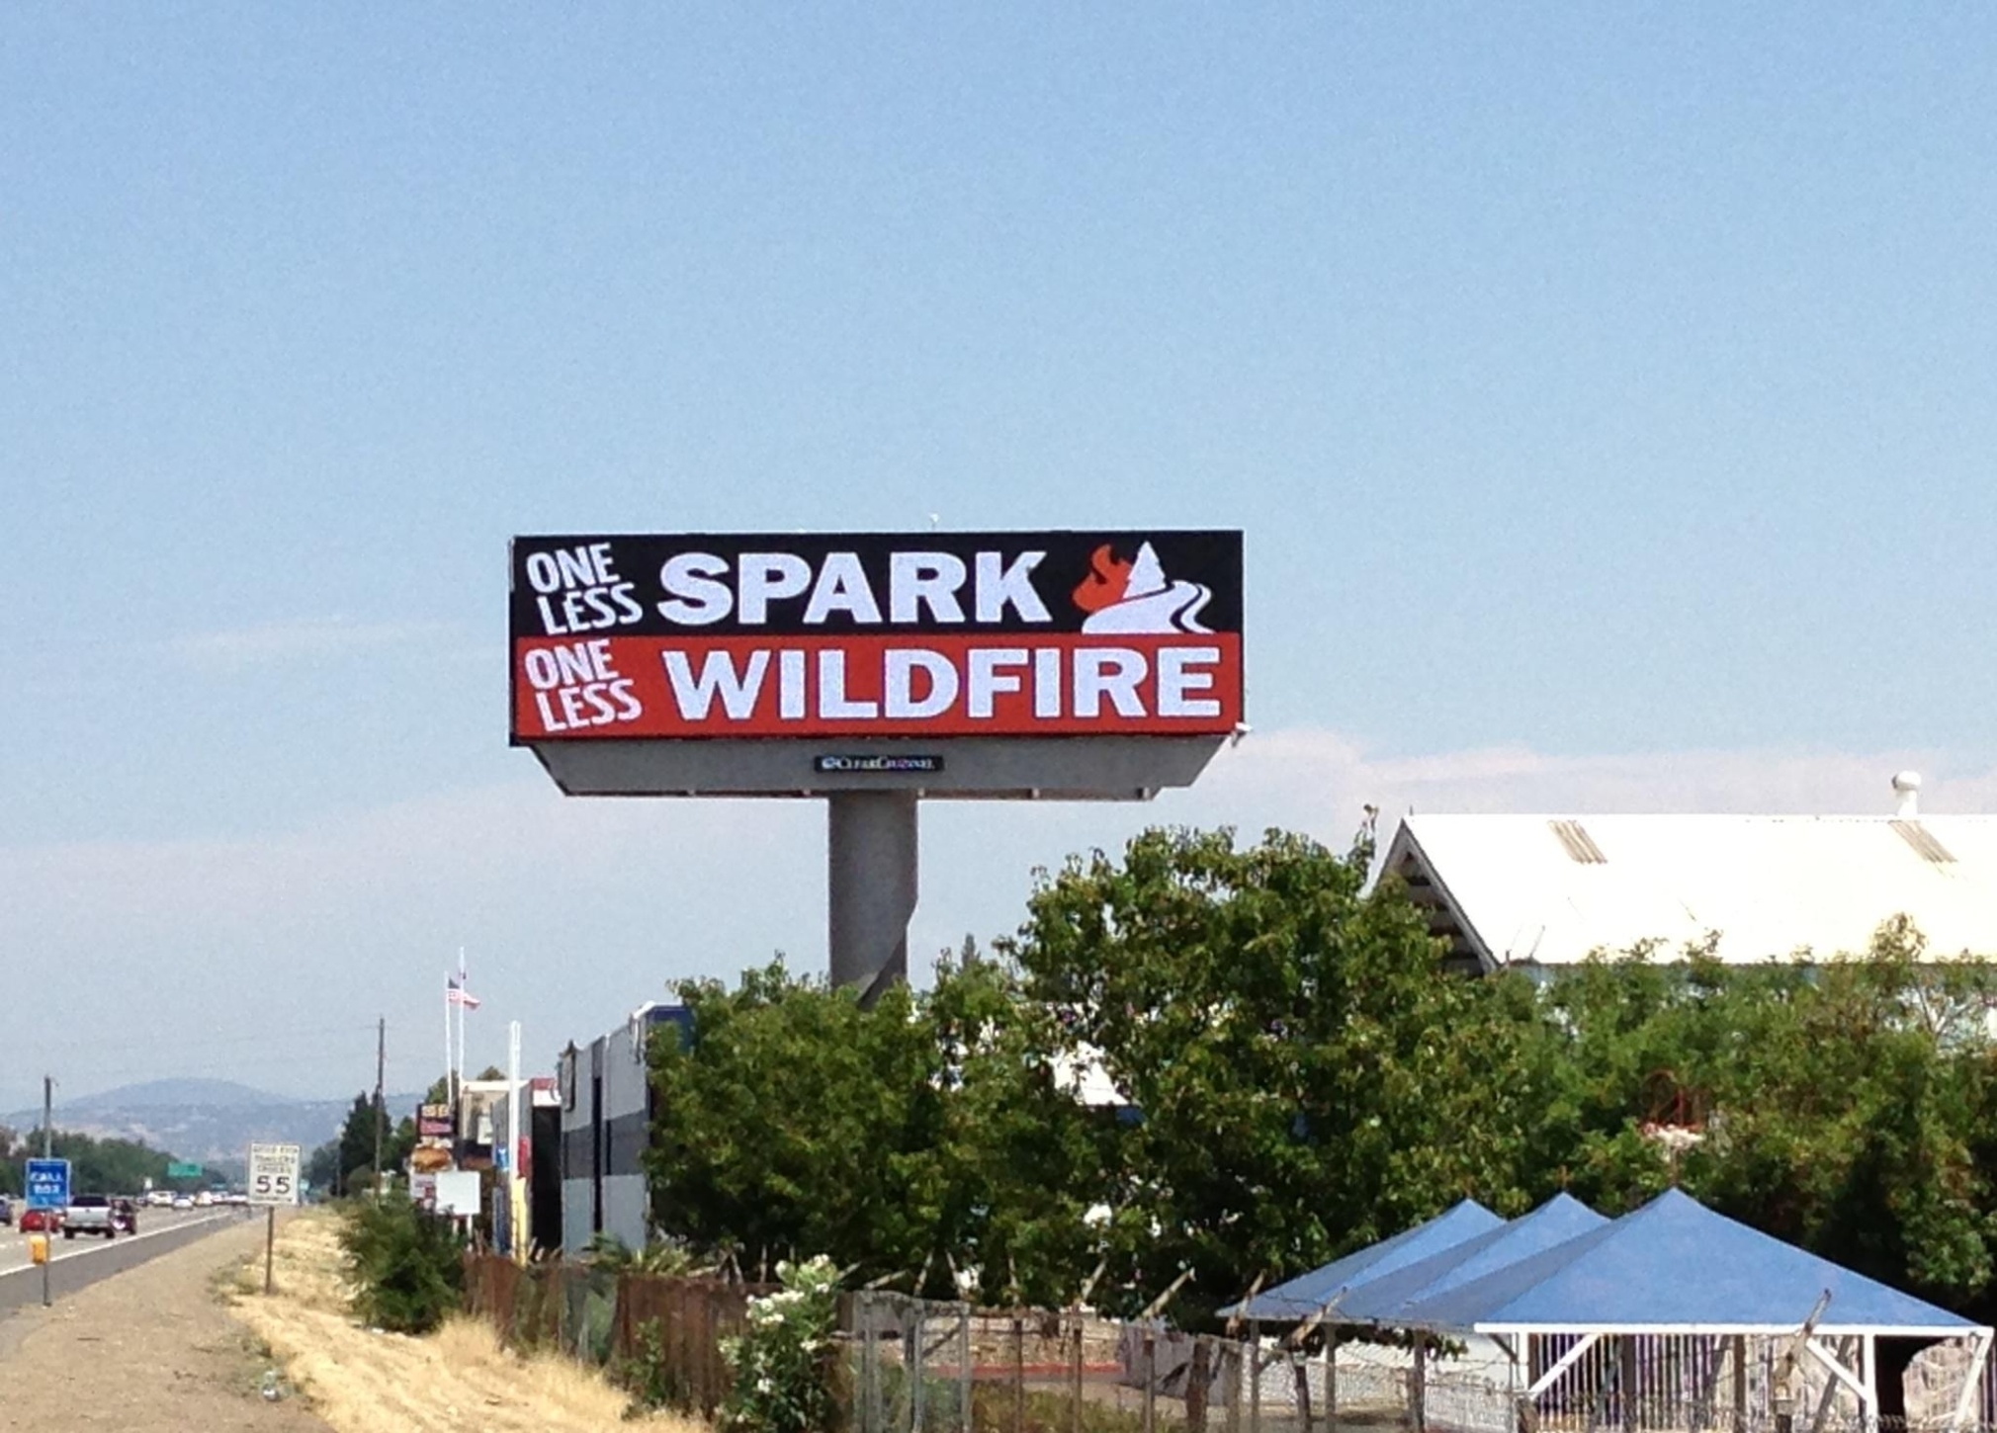

Slide 14
Website
The new prevention website that contains One Less Spark-One Less Wildfire information along with other very informative features, is active and ready for use!
Here is the web address: http://www.preventwildfireca.org/

Slide 15
Contacts
USFS Region 5 Prevention Coordinator
Ron Hodgson 707-562-8877
USFS Project Operations
Joe Aragon 928-713-0229
USFS R5 Prevention Chair
Beth Brady 530-543-2880
USFS R5 Prevention Co-Chair
Jim Miguel 530-945-8671

Slide 16
Contacts Continued
Northern California Branch Director
Mark Thibideau 530-925-1642
Sacramento Central Branch Director
Devin Magee 530-310-3597
South Central Branch Director
Abby Bolt 530-391-6807
Southern Branch Director
Eddie Childs 661-400-9697

